Slide 1


Digital Control in Power Electronics
杭丽君
ljhang@hdu.edu.cn
2018/7/15
可再生能源及微型电力网技术实验室
Regeneration energy and microgrid Technology Lab(REMT)

Slide 2
课 程 内 容
Introduction: Digital Control Application to Power Electronic Circuits
The Test Case: a Single-Phase Voltage Source Inverter
Digital Current Mode Control
Extension to Three-Phase Inverters
External Control Loops

Slide 3
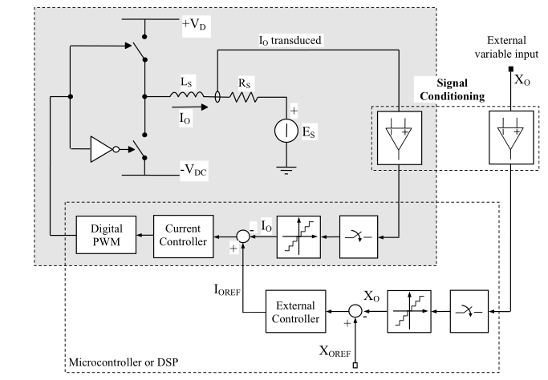
5.1 MODELING THE INTERNAL CURRENT LOOP
Typical organization of a multiloop digital controller.

Slide 4

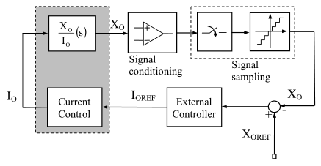




5.1 MODELING THE INTERNAL CURRENT LOOP
Block diagram of the external loop digital controller.

Slide 5
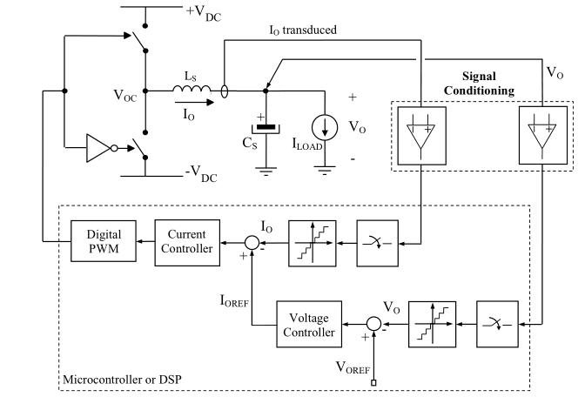
5.1 MODELING THE INTERNAL CURRENT LOOP
Typical organization of a single-phase UPS with digital control

Slide 6
5.2 DESIGN OF VOLTAGE CONTROLLERS
Uninterruptible power supplies (UPSs)
the voltage source inverter is used to implement a high-quality, controlled voltage source.
The structure of the inverter output filter has been modified with respect to what we have considered so far.
The output capacitor provides, at least partially, load power factor correction, and gives to the UPS an energy storage capability to sustain the load, in the absence of the primary source of energy, for a predetermined amount of time, known as hold-up time.

Slide 7
5.2.1 Possible Strategies: Large and Narrow Bandwidth Controllers
large bandwidth controllers:
The instantaneous compensation of any deviation of the output voltage from its reference. A typical problem in UPS systems is the limitation of the output voltage waveform harmonic distortion within acceptable, product standard compliant, levels. This is a particularly hard task when nonlinear distorting loads are connected to the UPS output. Large bandwidth output voltage controllers try to achieve the goal by extending the regulation bandwidth so much as to make it include a significant number of fundamental frequency harmonics (10 or more).
(ii) narrow bandwidth controllers:
Examining the output voltage waveform distortion problem, one can realize that what is really needed is not the instantaneous compensation of all the undesired harmonic components. A harmonic compensation action that settles in a few fundamental frequency periods is actually enough to comply with product standards, provided that a relatively fast control of the fundamental harmonic component and a comparatively fast response to load variations is guaranteed.

Slide 8
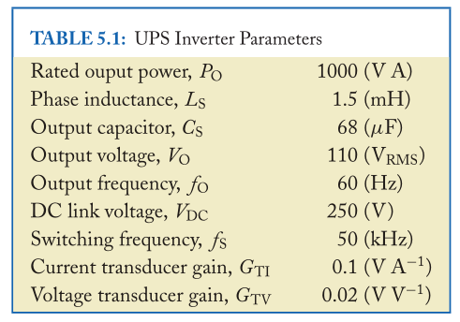
5.3 LARGE BANDWIDTH CONTROLLERS
5.3.1 PI Controller
The presentation of basic implementations of two output voltage control strategies for UPS systems:
PI control
dead-beat control
The complete list of converter parameters

Slide 9
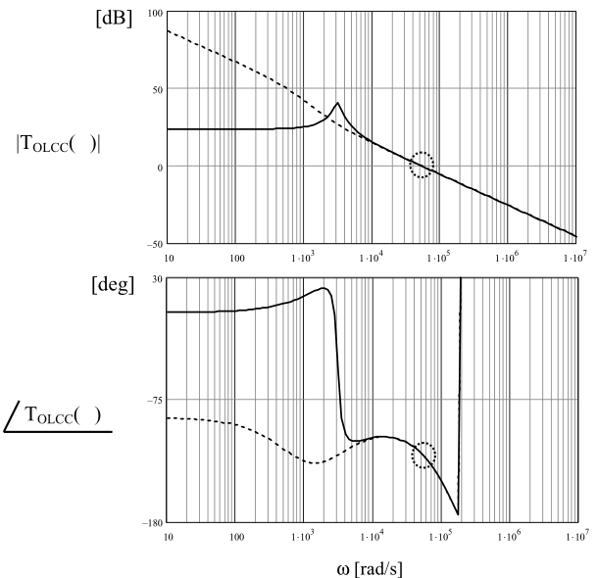


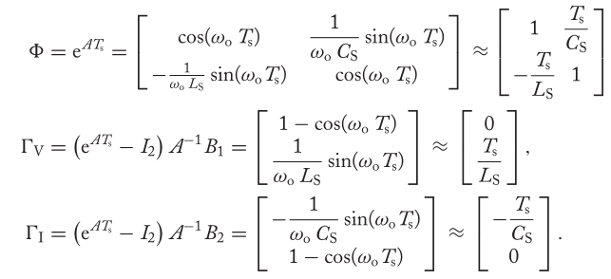
5.3.1 PI Controller
Bode plot of the current control open loop gain, with (solid line) and without (dashed line) output capacitor.

Slide 10
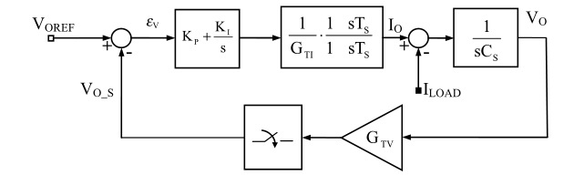



5.3.1 PI Controller
Block diagram of the voltage loop digital PI controller for the UPS

Slide 11
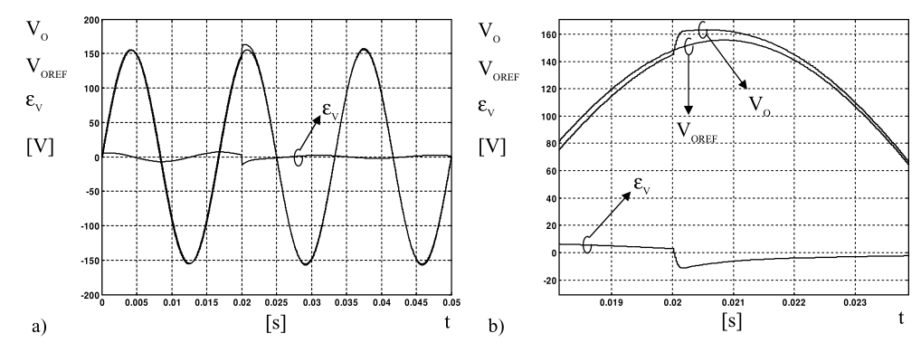
5.3.1 PI Controller
Dynamic response of the digital PI voltage controller:
(a)response to a step load disconnection: the load current instantaneously reduces from about 9.1 A RMS to 0; (b) details of the previous figure.

Slide 12
5.3.1 PI Controller
The steady-state reference tracking capabilities of the voltage controller are pretty fair. A steady-state sinusoidal tracking error is recognizable, that, as in the current loop case, is due to the finite amplification the PI controller offers at the reference frequency.
modifying the controller structure (as will be explained in Section 5.4)
adding some form of feed-forward compensation, e.g., of the capacitive component of the inverter output current.
The behavior illustrated by Fig in the last page can be considered a consequence of the regulator properties, not influenced by saturation effects or other system nonlinearities. The regulation bandwidth determines the significant voltage error peak at the instant of the load step change. This is recovered in a relatively small fraction of the reference period, with adequate damping, i.e., without ringing or persistent oscillations.

Slide 13
5.3.2 The Predictive Controller
It is indeed possible to implement a predictive controller for the voltage control loop and get again a very fast dynamic performance. Following this approach, it is possible to set up a multiloop controller based on decoupled current and voltage predictive regulators, whose dynamic response delay turns out to be equal to four modulation periods.
The more direct and well-known application of dead-beat control to the converter does not actually follow the multiloop approach. In this case, the direct pole allocation and dynamic state feedback are applied to the second-order system. A multivariable controller is consequently achieved, whose dynamic response delay is equal to three modulation periods, faster than the previously described one. However, as it almost always happens, the price to pay for the speedup is not negligible.

Slide 14
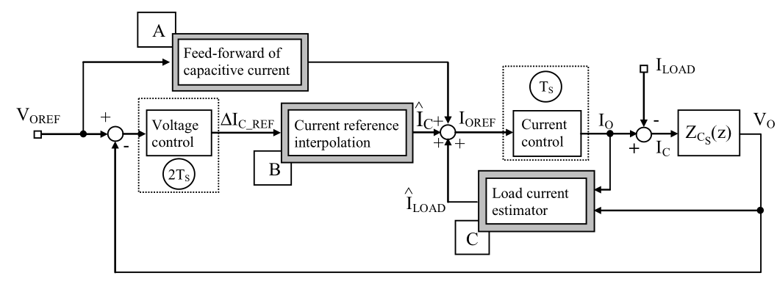
5.3.2.1 The Multiloop Implementation
Schematic organization of the multiloop predictive voltage controller.

Slide 15



5.3.2.1 The Multiloop Implementation
The voltage controller can be designed almost identically,
The basic estimation equation, which can be actually improved by adding a cascaded low-pass filter, so as to remove possible instabilities or measurement noise.

Slide 16
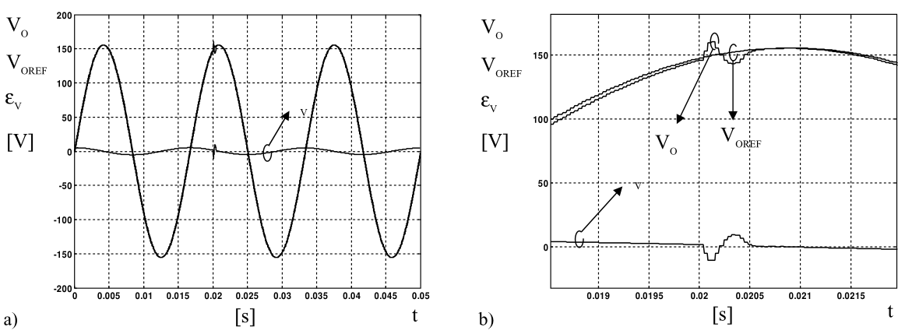
5.3.2.1 The Multiloop Implementation
Dynamic response of the digital dead-beat voltage controller: (a) response to load step disconnection; (b) details of the previous figure.

Slide 17

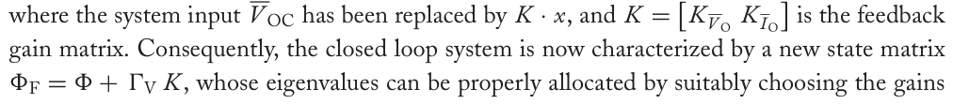



5.3.2.2 The Multivariable Implementation
the basic static state feedback implementation,
These values achieve the desired results, both the closed loop system eigenvalues are relocated in the origin of the complex plane.
the approach we are discussing here is only meaningful if we do not take into
account the dynamic decoupling hypothesis, this could be the only correct way
of synthesizing a dead-beat controller in all those cases where the second-order output filter
does not guarantee that the condition is satisfied.

Slide 18
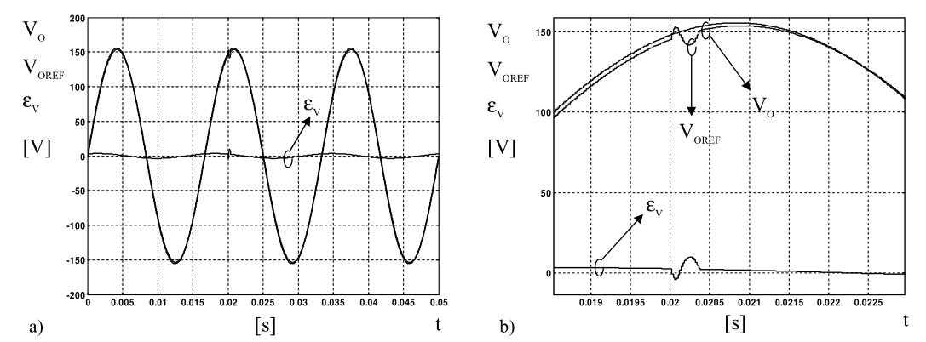
5.3.2.2 The Multivariable Implementation
Dynamic response of the digital dead-beat voltage controller: (a) response to a load step disconnection; (b) details of the previous figure.

Slide 19
5.4 NARROW BANDWIDTH CONTROLLERS
A summary of two very popular narrow bandwidth voltage control strategies, frequently employed in UPS systems. These are the repetitive-based voltage controller and, once again, the rotating reference frame voltage controller. The former is based a totally new concept we never encountered before, and the latter, instead, is almost the direct extension of what we have discussed in Chapter 4 for the current loop implementation. Essentially for this reason, we will here discuss a different implementation strategy for the same concept, which is based on DFT (discrete Fourier transform) filters.

Slide 20
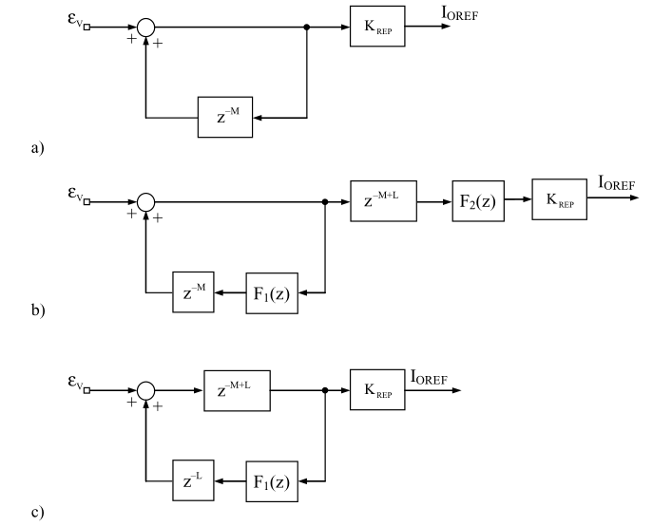
5.4.1 The Repetitive-Based Voltage Controller
(a) General implementation of the repetitive controller; (b) provisions to improve the stability margin; (c) the considered implementation.

Slide 21
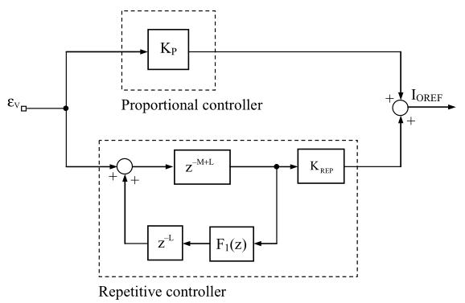
5.4.1 The Repetitive-Based Voltage Controller
(a) Suggested repetitive-based voltage controller. The repetitive controller structure of (c) in the last slide is connected parallel to a conventional purely proportional controller.

Slide 22
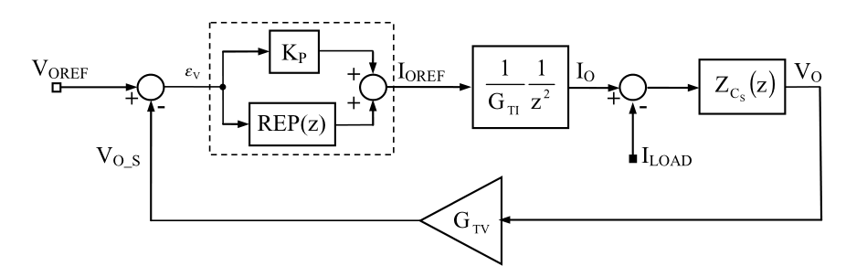
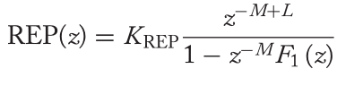
5.4.1 The Repetitive-Based Voltage Controller
Repetitive-based voltage control loop. The scheme is used for the computation of the open loop system gain.

Slide 23
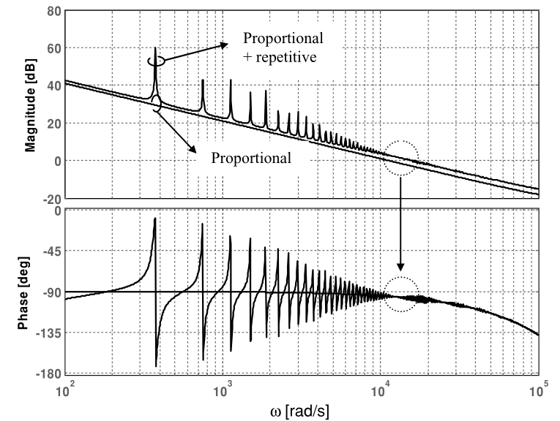
5.4.1 The Repetitive-Based Voltage Controller
Open loop system gain for the repetitive-based controller.

Slide 24
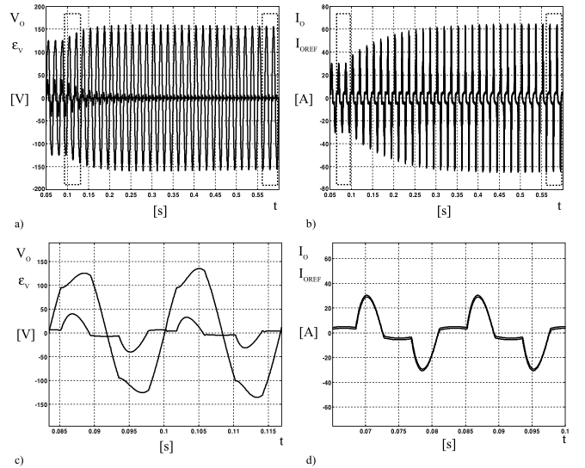
5.4.2 The DFT Filter Based Voltage Controller
Repetitive-based controller operation.
(a) output voltage transient
(b) output current transient
(c) details of (a) before the repetitive controller is activated
(d) details of (b) before the repetitive controller is activated

Slide 25
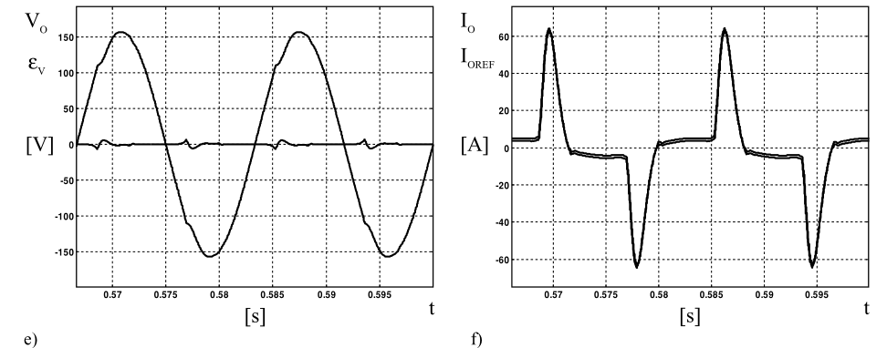
5.4.2 The DFT Filter Based Voltage Controller
(e) details of (a) after the steady state is reached with the repetitive controller;
(f) details of (b) after the steady state is reached with the repetitive controller.

Slide 26
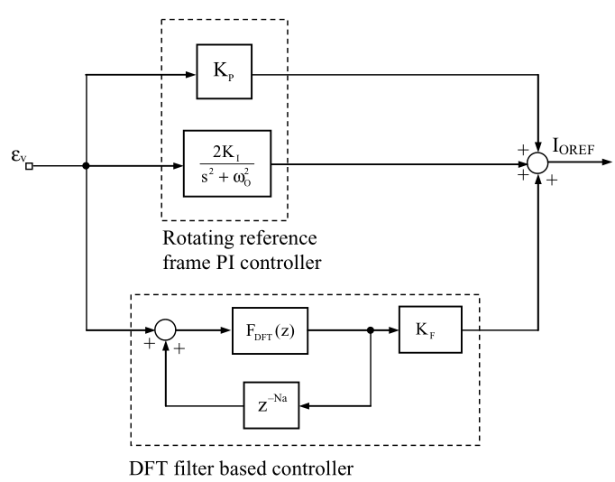
5.4.2 The DFT Filter Based Voltage Controller
(a) Suggested DFT filter based voltage controller. A rotating reference frame PI controller is parallel connected to the DFT filter based controller.

Slide 27
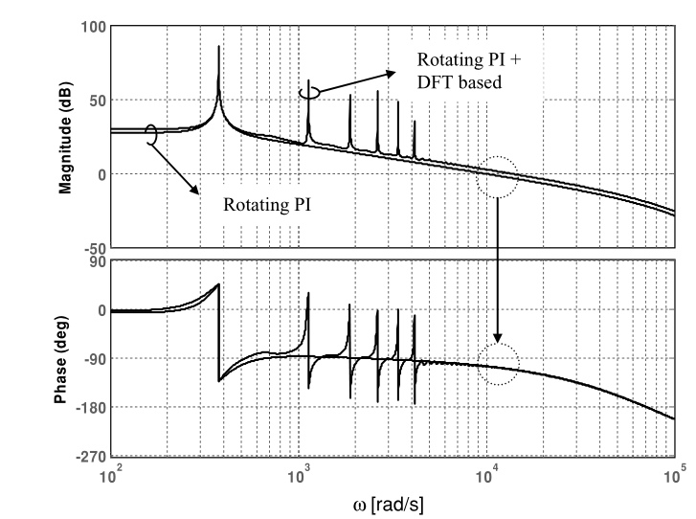
5.4.2 The DFT Filter Based Voltage Controller
Open loop system gain for the DFT-based controller.

Slide 28
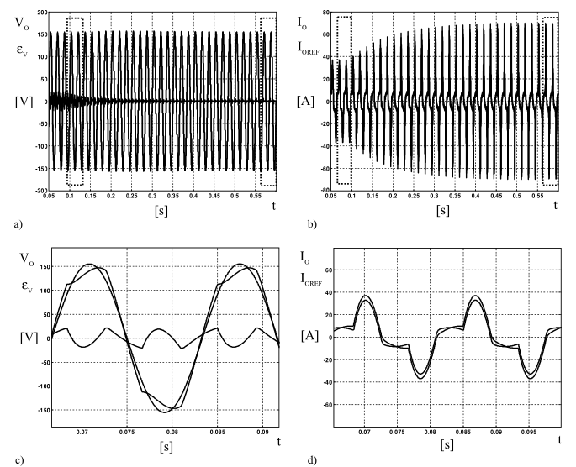
5.5 OTHER APPLICATIONS OF THE CURRENT CONTROLLED VSI
DFT filter based controller operation.
(a) output voltage transient;
(b) output current transient;
(c) details of (a) before the repetitive controller is activated; (d) details of (b) before the repetitive controller is activated;

Slide 29
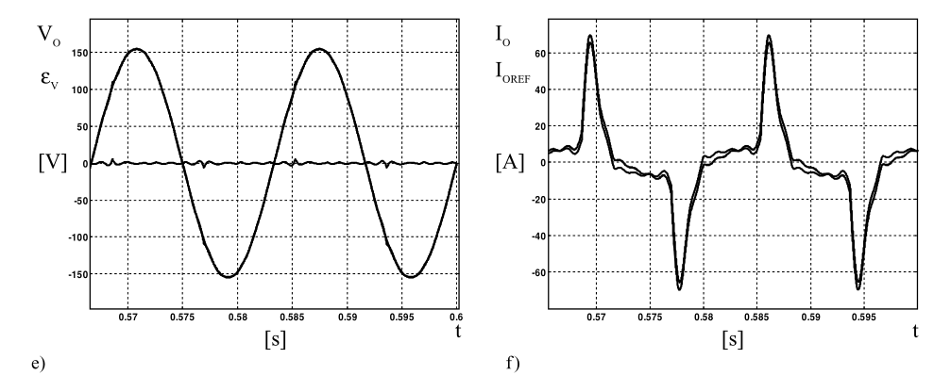
5.5 OTHER APPLICATIONS OF THE CURRENT CONTROLLED VSI
(e) details of (a) after the steady state is reached with the DFT-based controller;
(f) details of (b) after the steady state is reached with the DFT-based controller.

Slide 30
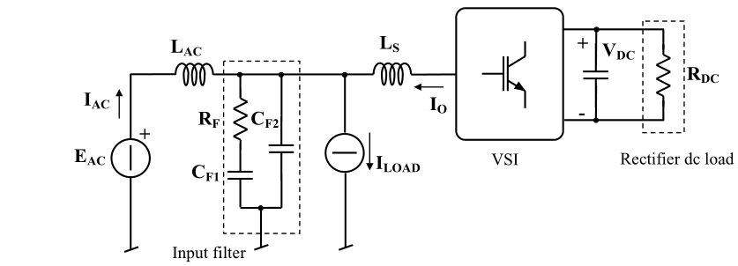
5.5 OTHER APPLICATIONS OF THE CURRENT CONTROLLED VSI
Typical organization of a controlled rectifier or active power filter.

Slide 31


5.5.1 The Controlled Rectifier
the voltage controller actually determines the amount of power absorbed by the rectifier from the ac source. In the steady state, this has to be equal to the sum of the load power and the converter losses. Instead, in dynamic conditions, the dc link capacitor can absorb or deliver the instantaneous power unbalance. Therefore, the fundamental equation that describes the power balance of the system is as follows:

Slide 32


5.5.1 The Controlled Rectifier
→ relates the controlled variable V_{DC} to the controller’s output G_{eq}
Since the linearization is based on variable perturbation and small signal approximation, the model will be only valid in the vicinity of a steady-state operating point.
which can be used in the design of the dc link voltage regulator. The design of the regulator can follow the same steps as in Chapters 2 and 3, with continuous time synthesis and successive discretization. The only caution we need to take is to limit the required bandwidth and keep it lower than the source fundamental frequency, so as to avoid source current distortion.

Slide 33

5.5.2 The Active Power Filter
I_{LOAD} generator is considered and used to represent the distorting or reactive loads the filter has to compensate, while the dc load, R _{DC} , may not be present.
If there is no dc load, the active power filter is not required to process any active power, with the exception of that due to its losses, and can thus be sized to sustain only the reactive and harmonic load currents.
From the source standpoint, the load will be seen as an equivalent resistor, absorbing only the active power required by the distorting loads.
The achievement of this objective requires again two different control loops:
a current control loop, used to impose the desired ac current I _{AC} to the source,
(ii) a dc voltage control loop, used to regulate the load voltage, V _{DC} , keeping it equal to a given reference value.
the inverter current reference:

